Slide 1

Visual Basic for Application (VBA) for Excel

Slide 2
Introduction to VBA

Slide 3
What is VBA (Visual Basic for Applications)
VBA stands for Visual Basic for Applications. It is the programming language for Excel and other MS Office Programs
VBA is a specialized version of Microsoft’s well-known Visual Basic language.
VBA is an Object-Oriented language within Microsoft Ofﬁce suite:
◦ Excel, Word, Access, and Power Point.
◦ We will focus on Excel.
◦ Shortcut to access the VBA interface in Excel: Alt+F11.

Slide 4
Why Learn VBA for Excel
Automation
Repetitive tasks done using keyboard and mouse can be automated using VBA thus improving efficiency.
Data Analysis
VBA allows users to do analysis and complex computation that can not be done using the built in formulas
It makes Excel Smart
Using VBA can make the Excel Spreadsheet to respond to user’s interaction with the spreadsheet.
Enhance User Experience
VBA can enhance user’s experience by integrating forms within the spreadsheet which improves ease of use and promotes interactivity.
Security
VBA can be used to provide security on the spreadsheet. Users can limit modifications or editing of the spreadsheet as well as add password protection on the spreadsheet in case it contains sensitive information.

Slide 5
Practical Uses of Excel with VBA (Excel Applications)
Investment Research
One way of using VBA with Excel is to analyze Market trends. VBA can be used to automatically get data from online resources or database and present it for analysis.
Sales Brochure and Quotations
VBA allows Excel to serve as a Brochure, using interactive forms and create quotations for customers.
Budget or Forecast Models
VBA will allow users to create budget or forecast models programmatically within excel.
And Many More…
VBA makes Excel versatile that you can almost create anything.

Slide 6
Coding with VBA
There are two approaches to write code in VBA:
Macro Recording
Standard Coding
The Macro approach “records” a series of mouse-clicks and keyboard strokes.
Advantage: Corresponding VBA code is created automatically and recorded for you.
Disadvantage: It’s limited.
To tackle this limitation, we use a mixed approach:
First, record a simple macro.
Then, tweak it to achieve more complex tasks.

Slide 7
The VBE (Visual Basic Editor)

Slide 8
Accessing the VBE
There are two ways of accessing the VBE.
Shortcut Key (Pressing ALT + F11)
Via Developer’s Tab

Slide 9
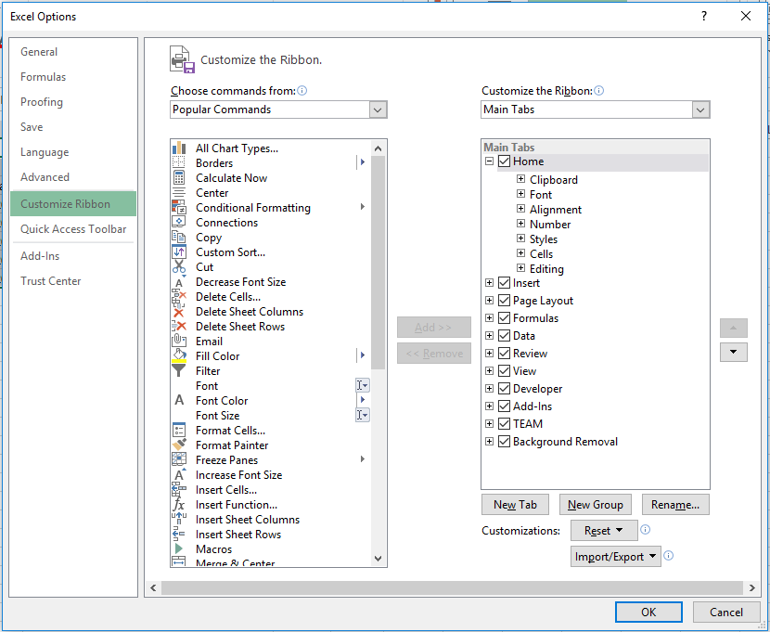
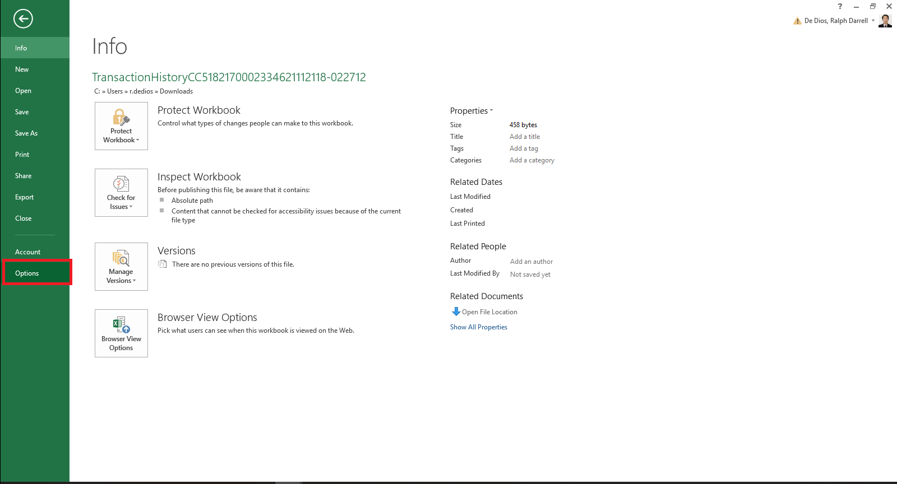
Enabling Developer Tab
Developer’s Tab is disabled by default.
To display the DEVELOPER tab, click on the File menu > Options. When the Excel Options window appears, click on the Customize Ribbon option on the left. Click on the Developer checkbox under the list of Main Tabs on the right. Then click on the OK button.

Slide 10
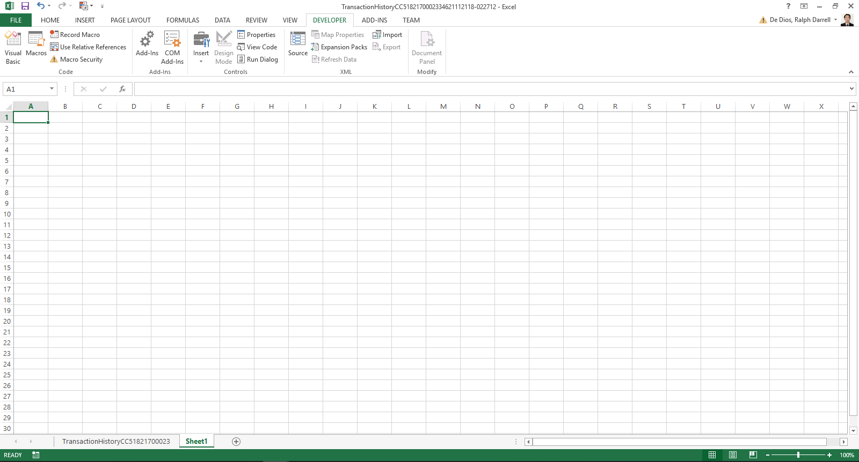
Enabling Developer Tab
Disabled
To enable design mode in developer tab, save as the worksheet as “Excel Macro-Enabled Worksheet”

Slide 11
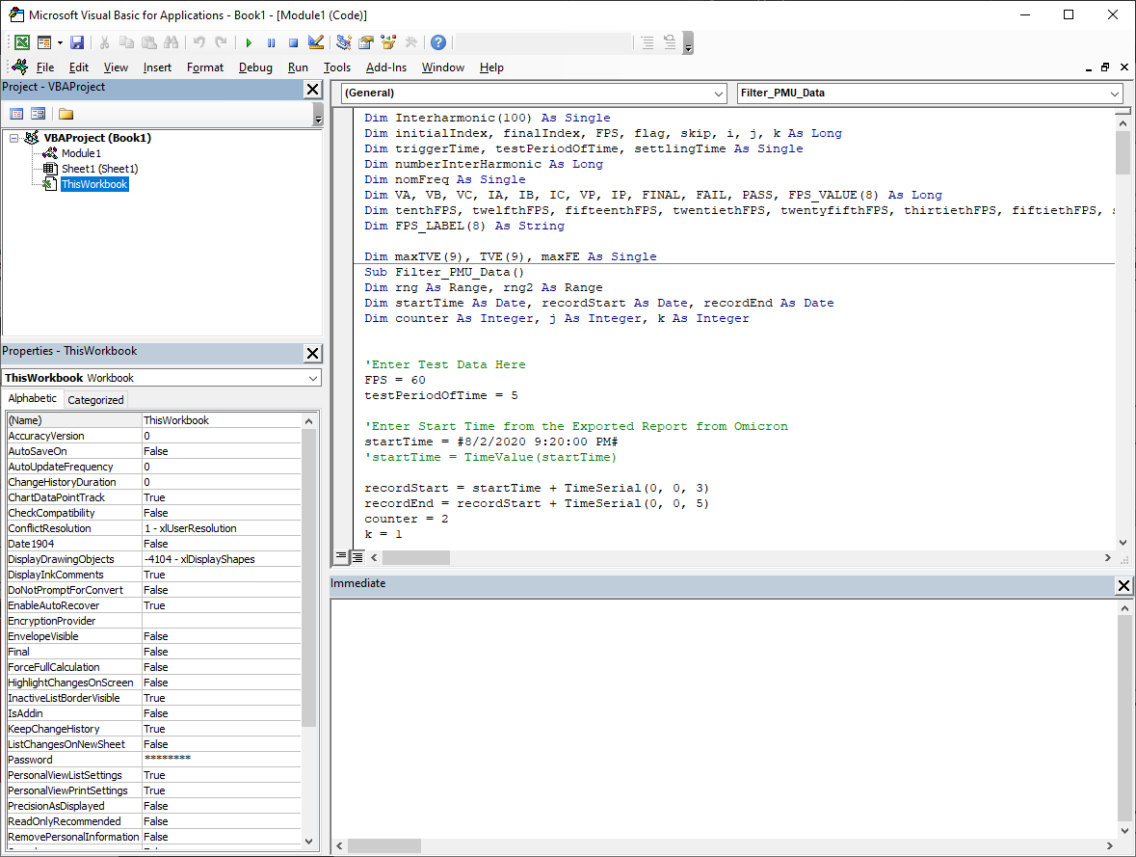
Visual Basic Editor
Toolbar
Menu Bar
Object
Procedure
Project Explorer
Code Editor
Properties Viewer
Immediate Window

Slide 12
The Project Explorer
The project explorer displays the list of projects open and all of the items contained in the project.
Depending on the project that is open, users can view four kinds of objects.
Microsoft Excel Objects – Describes the MS Excel Objects in the project. Usually includes ThisWorkbook object and Worksheet object.
Forms – Describes the User Created forms that can be added to the project
Modules – This is the container for the procedures of the project.
Class Modules – special modules that will let user to create custom objects.

Slide 13
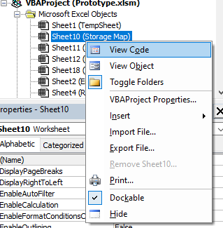
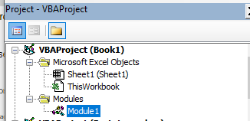
The Project Explorer
Each of the objects in the Project Explorer is associated with VBA Code. Users can view it by either:
Double Clicking on the Object
Right Click on the Object and Select on View Code
Select the desired object and clicking on the View Code Button

Slide 14
Immediate Window
The Immediate window displays information resulting from debugging statements in your code or from commands typed directly into the window.
The Immediate Window is used for the following primary tasks.
Display Output during the debugging process
Inspect status of objects and variables while in Break Mode
Execute statements.

Slide 15
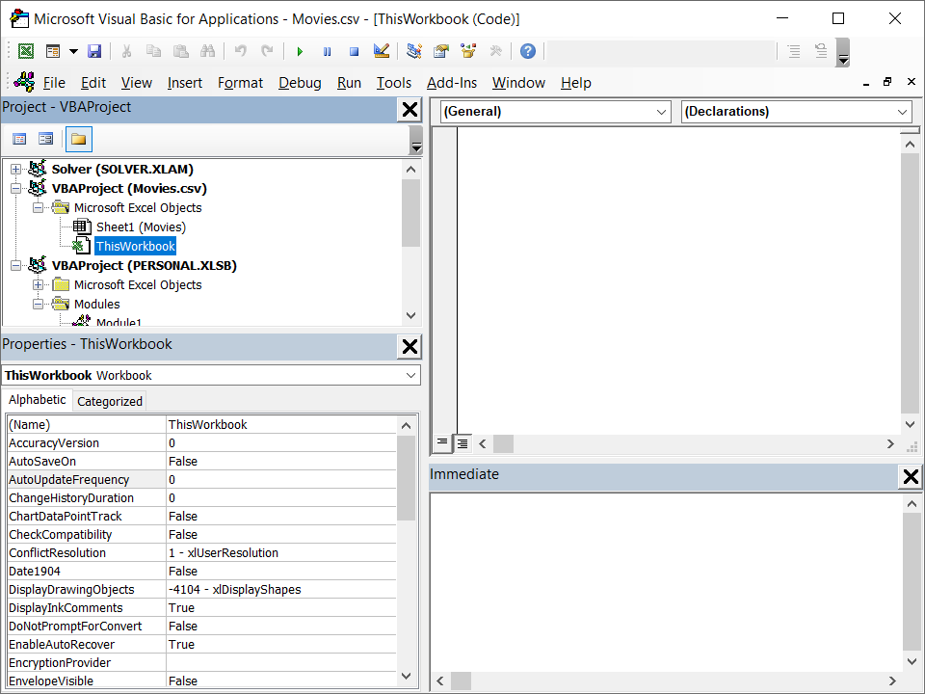
Properties Window
The Properties Window displays the properties of the object that is currently selected in the Project Explorer and allows you to edit those properties

Slide 16
Module Management

Slide 17
Adding Components
When starting a VBA project, whether it be VBA coding or via Macro Recording, you will need to add and remove components on the project. This includes modules, class modules, and/or user forms

Slide 18
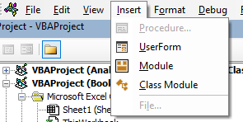
Adding Component
For the most part you need to add components in your project to start VBA programming.
To add a module for your project, you can perform the following:
Click on Insert, and select the component you wanted to add
Note: Be sure to Select the appropriate project where you wanted to add the component. Especially when you have multiple workbooks open.

Slide 19
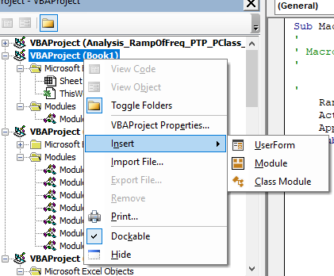
Adding Component
2. Right Click on the appropriate project. Click on Insert and select the desired component to add.

Slide 20
Adding Component
Upon adding components to your project, it is good practice to name each component accordingly. Chances are, you will be referring to these names on other codes you created. Also, it will be harder to change the name of the components later as codes that refers to that object may malfunction .

Slide 21
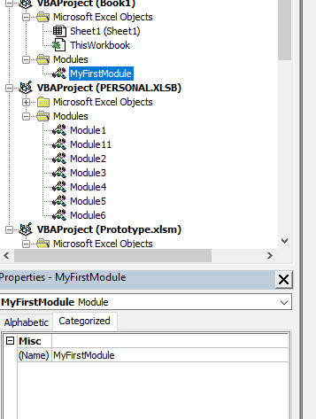
Adding Component
To name a component, select it in the Project Explorer and use the Properties Window to change the Name of the Component.

Slide 22
Removing Components

Slide 23
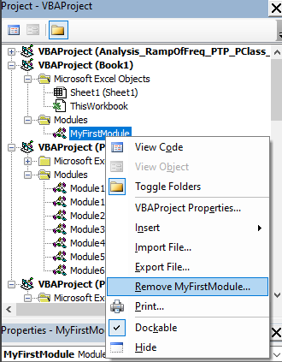
Removing Component
Removing components from your project can be done by right clicking on the component you wished to remove and selecting Remove ComponentName.

Slide 24
Importing and Exporting Components

Slide 25
Importing and Exporting Component
Moving components between Excel projects is easy, however you can also import and export components. Exporting and Importing components is usually done to re use components on other projects.
To Export a component, right-click the component in the Project Explorer and choose Export File, then navigate to the folder where you want to store the file and supply a filename.
To Import a component, right-click the project or any item associated with the project in the Project Explorer, choose Import File, navigate to the folder where the component is stored, select the file, and click Open.

Slide 26
Object Viewer
Coding using VBA let users to interact with Excel. This will include manipulating Excel’s features and functionality by using Excel’s various object. Excel contains various objects that we can use in coding. Obtaining information regarding these objects as reference could help coders use the appropriate objects.
Users can use the Object Browser to view information regarding Excel Objects. Users can view an object library where it lists all available objects that can be used. For each object, a list of the object’s members and for each members, information regarding that object’s member.

Slide 27
Object Viewer
Uses of the Object Viewer
View information for all object libraries
Provide information regarding the components of a project,
Access Help resources for an object member
Search for text in the Excel Object Library

Slide 28
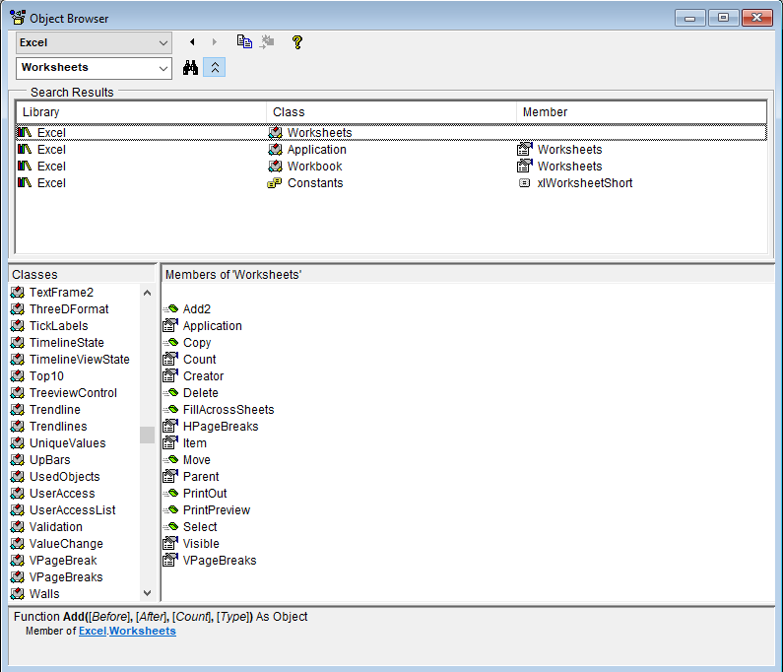
Object Viewer - Window

Slide 29
Developing Macros

Slide 30
Creating Macro with the Macro Recorder

Slide 31
Macro Recording - Introduction
The macro recorder is a very useful tool included in Excel. It records almost every actions performed. All you need to do is record the series of steps for a specific task once and you can execute the task over and over with the click of a button or with a shortcut.
Note however that it will record “Every” action you made while recording is in effect and that includes scrolling and other actions you made.

Slide 32
Macro Recording - Access
There are two ways to access Macro Recording in Excel:
Via the Developers Tab
Via the View Tab

Slide 33
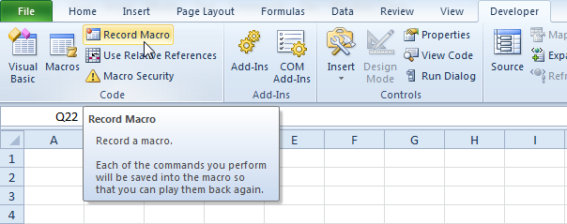
Macro Recording – via Developer Tab
On the Developer Tab, click Record Macro.

Slide 34
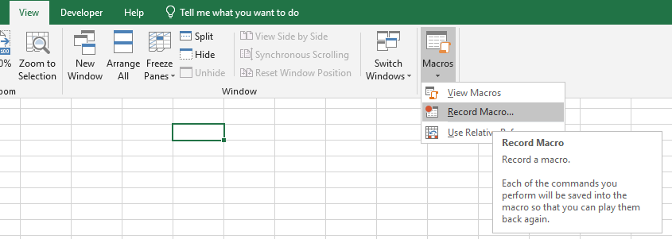
Macro Recording – via View Tab
On the Developer Tab, click Record Macro.

Slide 35
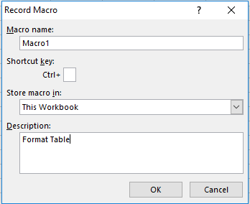
Macro Recording – Creating Macro
Enter a name
Select “This Workbook” from the drop-down list. As a result, the macro will only be available in the current workbook.

Slide 36
2. Editing a Macro

Slide 37
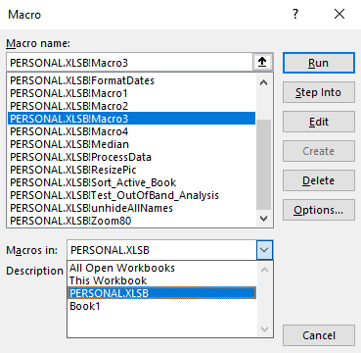
Editing Macro
After Recording your Macro, you can edit it by accessing the Visual Basic Editor.
You can access the Macros via Visual Basic Editor by:
View Tab > Macros. Select the recorded Macro and Click on Edit Button
Developer Tab > Macros. Select the recorded Macro and Click on Edit Button

Slide 38
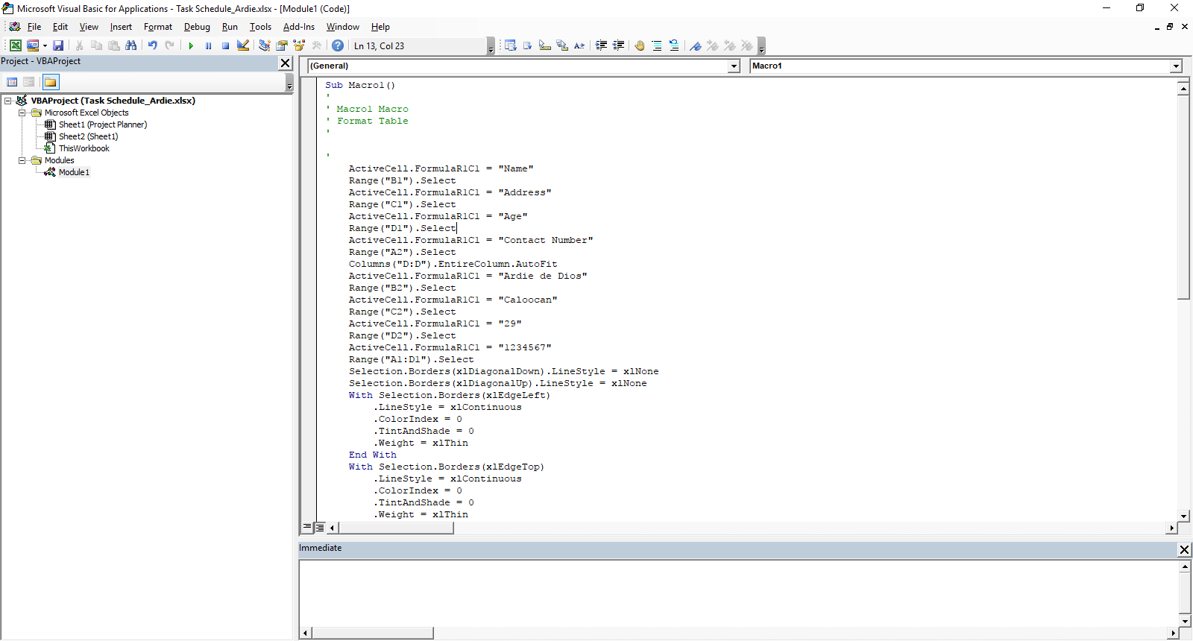
Editing Macro
The purpose of editing macros is to fine tune the macro and removing those undesirable steps that are recorded.

Slide 39
Running your Macro – Macro Window
To run a Macro, Users need to view the macro first via Developer or View. Instead of hitting the Edit Button, Hit the Run Button.

Slide 40

Running your Macro – via VBE
Open the macro through VBE. You can run the macro by:
Press F5 to run the macro
Click on the Run Button

Slide 41
3. Message Box

Slide 42
MsgBox Function
One very useful function in VBA programming is making use of the MsgBox. You can use this function to display various information to the user. You can also use this to get Yes/No Confirmation from the user. This is one of the most useful functions you need when starting your VBA programming journey.
Msgbox Syntax is as follows:
MsgBox(prompt[, buttons] [, title] [, helpfile, context])
where:
prompt – is the text you want to display in your message box. This is required.
buttons – is the parameter that controls what buttons are to be used in the Msgbox.
title – is the parameter that controls what is written in the Title Bar.

Slide 43
3. Input Box

Slide 44
InputBox Function
The InputBox Function allows the users to capture simple input from your user.
InputBox Syntax is as follows:
InputBox(prompt, [title], [default], [xpos], [ypos], [helpfile], [context])
where:
Prompt – required parameter. The message displayed for information
Title - an optional parameter. This is what is written in the Title bar.
Default – An optional parameter that, if supplied, default value in the input area of the input box.
Xpos – An optional parameter that specifies the distance between the left edge of the input box
and the left edge of the window. If omitted the input box is horizontally centered.
Ypos – An optional parameter that specifies the distance between the top edge of the input box
and the top edge of the window. If omitted the input box is about 1/3 of the way down the screen.
Helpfile – An optional parameter that specifies the help file used to provide context-sensitive
help. If this parameter is provided, you must also provide a context parameter.
Context – An optional parameter that specifies the help context number of the appropriate help
topic. If this parameter is specified, you must also provide the Helpfile parameter.

Slide 45
Getting Started

Slide 46
The Building Blocks

Slide 47
The building blocks for VBA programming are the Module, Forms and Class Modules.
Modules is the most used building block for Excel VBA. This serves as the container for your code and discrete sections of codes are called procedures.
For simple project, you can use one module containing one or more procedures. However, for complex projects you can have as many modules.
One advantage of using multiple modules is that it allows programmers to group related procedures.

Slide 48
Modules
Modules serves as a home for your code. This serve to contain procedures that are related, provide a means for declaring variables that can be accessed by all module procedures and the ability to hide private procedures from other modules.
Module Behaviors can be customized in various ways:
Option Explicit – With this, the programmer needs to declare every variable.
Option Private Module – This option makes the code in the module as private.
Option Compare {Binary|Text|Database} - specifies the string comparison method (Binary, Text, or Database) for a module.
Option Base {0|1} - specifies the first index number of an array.

Slide 49
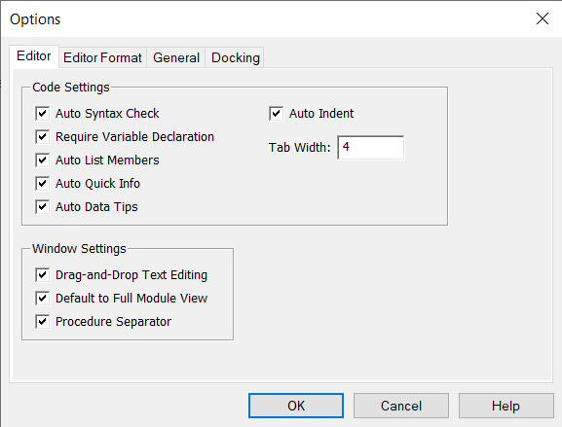
Option Explicit
When this is used, user needs to declare every variable in the module, otherwise syntax error will occur and the code will not compile.
It is also highly recommended as well to declare variables every time it is used as it eliminates subtle and not so subtle bugs in your code.
If you misspell a variable that you have used without Option Explicit declared, VBA will assign to it a new variable to use based on that variable, this will likely not contain the correct value.
This statement can be automatically be included in every module. On the VBE, select Tools > Options and check on the Require Variable Declaration Checkbox.
Automatically including Option Explicit in Every Module.

Slide 50
Option Private Module
This option marks the code in the module as private so that it can’t be seen by users in the Macros dialog box.
It also prevents a module’s contents from being referenced by external projects.
This statement should appear in the declarations section of a module before any procedure

Slide 51
Option Compare {Binary|Text|Database}
The Option Compare statement specifies the string comparison method (Binary, Text, or Database) for a module. If a module doesn't include an Option Compare statement, the default text comparison method is Binary.
Option Compare Binary results in string comparisons based on a sort order derived from the internal binary representations of the characters. In Microsoft Windows, sort order is determined by the code page.
Option Compare Text results in string comparisons based on a case-insensitive text sort order determined by your system's locale. When the same characters are sorted by using Option Compare Text, the following text sort order is produced
Option Compare Database can only be used within Microsoft Access. This results in string comparisons based on the sort order determined by the locale ID of the database where the string comparisons occur.
* From docs.microsoft.com

Slide 52
Option Base {0|1}
Used at the module level to declare the default lower bound for array subscripts.
Because the default base is 0, the Option Base statement is never required. If used, the statement must appear in a module before any procedures. Option Base can appear only once in a module and must precede array declarations that include dimensions.
From docs.microsoft.com

Slide 53
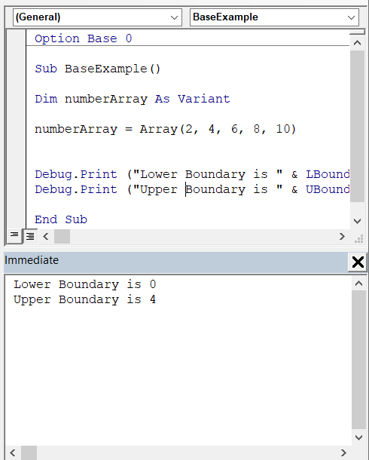
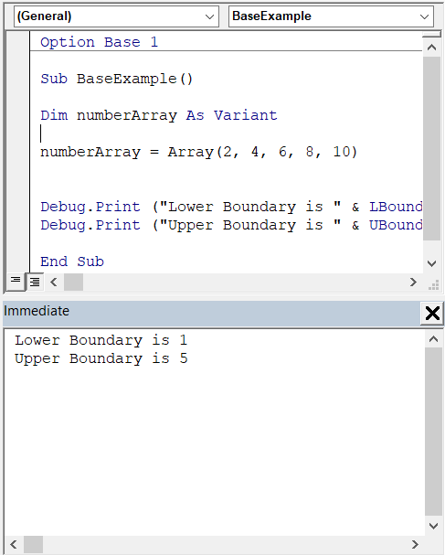
Option Base {0|1}
Base 0 Example
Base 1 Example

Slide 54
Procedures

Slide 55
Procedures
Procedure is a collection of statements that performs one or more tasks.
When creating VBA code, you will encounter two types of procedures namely: subroutines and functions.
Subroutine is the smallest element of a program that can be executed. This does not return any value
Functions are like sub routines but they allow you to return a value to the calling procedure.

Slide 56
SubRoutine
The General Syntax of a subroutine is as follows:
[Private|Public|Friend][Static] Sub SubRoutineName ( (parameters) )
[statements]
End Sub

Slide 57
Calling SubRoutine
Once completed, subroutines can be called or executed by other subroutines simply by placing the name of the subroutine at the desired location in the calling subroutine. Alternatively, you could use the Call statement.
If you call a subroutine that has parameters, simply list the parameters after the subroutine separating multiple parameters with commas.

Slide 58
Function
Functions go a step further than subs in that they can return a value to the procedure calling the function.
The General Syntax of a function is as follows:
[Private|Public|Friend][Static] Function FunctionName ( (parameters) ) [As Type]
[statements]
FunctionName = FunctionResult
End Function

Slide 59
SubRoutine and Function Keywords
Private The private keyword is optional. A private subroutine can only be executed by other subroutines or functions in the same module.
Public The public keyword is optional. A public subroutine can be called by any other subroutine, function, or class module. Sub routines are public by default.
Static A static subroutine remembers the values of its local variables between calls.
Parameters You can declare one or more parameters for use by the subroutine. When you specify a parameter, any procedure that calls or executes the subroutine must supply a value for any required parameters
Type When you declare a function, you should also specify the return value’s data type. If you do not specify a data type, the function will return a variant.

Slide 60
Variables

Slide 61
Variables represents items or objects in a program. They are values that are stored in a computer memory or storage system.
These values in the memory can be accessed or changed during program execution.
In VBA, you can manipulate programmatically anything in Excel that you can interact with by using variables. To do this:
Create a variable that describes the object you will be interacting with.
Assign an initial value on the said variable.
Interact with the variable by performing operations or executing statements.

Slide 62
Data Types
On Excel VBA, it is not necessary to always declare the variable data type. Sometimes all you need to do is to declare the name and VBA can infer the data type when the variable is used. However, it is much safer and is a good programming practice to declare the data type you will be using.

Slide 63
Data Types
There are quite a few VBA data types, but for the general purpose not all of them are used. Below is a list of common VBA variables (known as data types) used in macros and their purposes:
Integer: Used to store number values that won’t take on decimal form.
Single: Used to store number values that may take on decimal form. Can also contain integers.
Double: A longer form of the single variable. Takes up more space, but needed for larger numbers.
Date: Stores date values.
String: Stores text. Can contain numbers, but will store them as a text (calculations cannot be performed on numbers stored as a string)
Boolean: Used to store binary results (True/False, 1/0)
Again, there are other data types, but these are the most commonly used for creating macros.

Slide 64
Variant Data Types
A variant Data Type is a data type that can represent any kind of value.
Variants can support user-defined types.
Variants can hold arrays
Variants can also support special values such as Empty, Error, Nothing and Null.
Programmers can test for the Variant’s data type by using the VarType Function. The syntax is as follows:
VarType(varname)

Slide 65
String Functions
VBA Strings are one of the mostly used data type in VBA. It is ALWAYS enclosed in “ “. Manipulating Strings is one of the skills you need to develop when programming in VBA as most of the conditions that you need to evaluate needs string manipulation.
Below are some of the most commonly used String operations:
& (Concatenating or Appending) - the operator & is mostly used when combining strings with other strings or other data types.
Join (Convert Array to String) – This will create a string containing the items of the array separated by a space.
StrConv (Convert the string) – this will convert the string to Upper Case or Lower Case or Proper Case or Unicode or Wide or Narrow.
Left, Right, Mid – Extract a part of a string.
Format – Format a string to a specific Number format
Instr, InstrRev – Searches for a character in a String.
String – This will generate a String of repeated characters
Len – Returns the length of the string or the number of characters in a string
LTrim, RTrim, Trim – This will remove leading spaces
Replace – Replace a part of the string
StrReverse – Reverse a string
Split – Converts String to array

Slide 66
Declaring Variables
The basic syntax for declaring a variable is:
Dim VariableName [As DataType]
Data Type is Optional, however if DataType is not specified, it will be give a Variant Data Type.

Slide 67
Variable Scope
The scope of the variable is determined by the location of the variable declaration or by the use of Private or Public keyword.
Variable’s scope can be:
Procedural Scope – These are variable that are declared within a procedure. These variables can only be accessed with code that resides in the procedure where the procedure is defined or declared.
Modular Scope – These are variables that are declared within a module. These variables are declared at the top of the module. These variables are accessible with code within the module.
Global Scope – When Module level variable is added with a Public keyword, this will make the variable a Global variable. These variables can be accessed by any code within the same project.

Slide 68
Variable Lifetime
Variable lifetime refers to the period of time from which you can use a variable until it is unloaded or removed from the computer’s memory.
Procedure-Level – the variable can be used the moment the procedure begins executing until it is finished. When the procedure is executed the next time, a new set of variables are created.
Module-Level – the variables can be used the moment the workbook containing the code is opened until the workbook is closed. The value of a module-level variable will remain until it is changed or until the workbook is closed.
Global-Level – the variables can be used the moment the workbook containing the code is opened until the workbook is closed. The value of a module-level variable will remain until it is changed or until the workbook is closed.

Slide 69
Constants
Constants are like variables, however, the values of constants never change. Unless, the value is changed explicitly in the source code.
Constants are private by default.
Declared at the module level, constants can be declared as public.
Constants’ naming convention is All Capitals.
VBA chooses a type for the constant if data type is not indicated.

Slide 70
Operators

Slide 71
Types of Operators
Arithmetic Operators – These are operators that are used for mathematical operations
Comparison Operators – These are operators that are used for comparing values.
Concatenation Operators – These are operators used in manipulating of Strings.
Logical Operators – These are operators that are used to perform logical operations.

Slide 72
Arithmetic Operators
Operator | Action
^ | The power operator
* | The multiplication operator
/ | The division operator
\ | The integer division operator (divides two numbers and returns the result)
Mod | The modulus operator (divides two numbers and returns the remainder)
+ | The addition operator
- | The subtraction operator

Slide 73
Logical Operators
Operator | Action
And | Logical Operator And (Returns True if Both Expressions are true)
Or | Logical Operator Or (Returns True if either of the Expressions are true)
Not | Negates an evaluation (negates the Logical Value)

Slide 74
Comparison and Concatenation Operators
Comparison Operators
Concatenation Operators
Logical Operators
Operator | Description
= | Returns true if Values are Equal To
< > | Returns true if Values are Not Equal To
< | Returns true if Values are Less Than
> | Returns true if Values are Greater Than
<= | Returns true if Values are Less Than or Equal To
>= | Returns true if Values are Greater Than or Equal To
Operator | Description
+ | Concatenates two Values
& | Concatenates two Values
Operator | Action
And | Logical Operator And (Returns True if Both Expressions are true)
Or | Logical Operator Or (Returns True if either of the Expressions are true)
Not | Negates an evaluation (negates the Logical Value)

Slide 75
Objects

Slide 76
Objects
Objects are the items that you can manipulate in your program.
Most of coding involved in VBA is manipulating Excel Objects to obtain the desired behavior.
In Excel VBA, there are objects such as Workbook, Worksheet, Range Object, etc. Any item that you can interact with in Excel can be available as an Excel Object.

Slide 77
Statements

Slide 78
Statements
Statements are essential for the VBA programming language. It can contain keywords, operators, variables, constants, and expressions.
Statements are classified into the following categories:
Declaration Statements – declare or names variables, constants or procedures and can also specify data type.
Assignment Statements – assigns a value or expression to a variable or constant.
Executable Statements – executes actions, can loop or branch through codes. They often contain mathematical or logical expressions.

Slide 79
Loop Statements
Loops are one of the most powerful statements. It allows programmers to repeat a block of code until a specific condition is satisfied
There are two types of loops:
Fixed Loops – loops that have a definite number of executions.
Variable Loops – loops that rely on logical expressions to complete.

Slide 80
Fixed Loop – For Next Loop
For…Next Loop Syntax:
For counter = start To end [ Step step ]
[ statements ]
[ Exit For ]
[ statements ]
Next [counter]
Where:
counter – is the number of times the code will repeat
start – is the beginning counter. Should be a numeric value
end – is the final value of the counter that the loop will execute
step – amount that will change the counter every loop. It defaults to 1 if not specified. This is optional.
statements – these are statements that are being executed
Exit For – used to exit the For Next Loop. This is optional

Slide 81
Fixed Loop – For Each Next Loop
For Each…Next Loop Syntax:
For Each element In group
[ statements ]
[ Exit For ]
[ statements ]
Next [element]
Where:
element – is the variable that will iterate through the elements of the collection or array.
group – this is the name of the object collection you will loop in
statements – these are statements that are being executed.
Exit For – used to exit the Loop. This is optional

Slide 82
Variable Loop – Do…Loop
Do Loop Syntax
First Variation
Do [{ While | Until } condition ] [ statements ] [ Exit Do ] [ statements ] Loop
Second Variation
Do [ statements ] [ Exit Do ] [ statements ] Loop [{ While | Until } condition ]
Where:
condition – the loop evaluates this to check it loop will repeat or not. If condition is Null it will be treated as False.
statements – these are statements that are being executed.
Exit Do – used to exit the Loop. This is optional
Note: For the second variation of the Do…Loop, the statement block executes at least once.

Slide 83
Conditional Statements
Conditional Statements are statements that makes a VBA program smart. It selects code to execute depending on the value of expression that is processed.
There are three conditional statements:
If...Then...Else – runs a specific block of code depending on the value of a condition.
Select Case – a variation of the If…Then…Else statement.
IIF – one line conditional statement

Slide 84
If…Then…Else
If…Then…Else Syntax:
If condition1 Then
block1
ElseIf condition2 Then
block2
Else
block3
End If
Where:
condition1 – is the first condition to be evaluated.
block1 – is the code block that will execute if condition1 results to true
condition2 – is the next condition to be evaluated if condition1 is false
block2 – is the code block that will execute if condition2 results to true
block2 – is the code block that will execute if all other conditions results to false

Slide 85
IIF
IIF statement:
IIf(expression, truepart, falsepart)
Where:
expression – is the first condition to be evaluated.
truepart – will be evaluated if expression is true
falsepart – will be evaluated if expression is false

Slide 86
Select Case Syntax
Select Case Syntax:
Select Case expression
Case value1
block1
Case value2
block2
Case Else
block3
End Select
Where:
block1 – is the code block that will execute if expression matches value1
block2 – is the code block that will execute if expression matches value2
block3 – is the code block that will execute if no other cases has been satisfied

Slide 87
Excel Object Model

Slide 88
Application Object

Slide 89
Application Object
This is the root of the Excel Object model which refers to the Excel Application as a whole.
The Application object provides functionality that gives your program a professional finish.
The Application Objects contains members that can be classified into the following:
Display-Oriented – these are members that modifies what the user see. These includes window sizing, what appears in the status bars, make a window visible or not among other things.
Excel References – these are members that gives quick access to excel objects. This includes members such as ActiveCell, ThisWorkbook and Selection.
File Operations – these members allows file operations such as Save, Open, Closing and all other operations.
System Information – these members are lets you get information regarding the computer environment on which you are running the application

Slide 90
Application.ScreenUpdating
This property’s main purpose is to speed up the processing of your macro code. This can be very useful for beginners as this can speed up execution of recorded macros.
What it does is that it will turn of updating of the screen, thus you will not be able to see what the macro is doing with the Application, thus eliminating the time of screen refresh thus decreases processing time.
Syntax:
Application.ScreenUpdating = [true or false]
Set to False so that the screen will not update and set to True so that screen will be updating.
NOTE: Always set screenupdating to True every time the macro ends or else the screen will need to be refreshed manually.

Slide 91
Application.Calculation
This property’s main purpose is to speed up the processing of your macro code by stopping calculation of formulas when running a macro.
Very useful when running macros on worksheets that contain large numbers of formulas that takes time to process.
Syntax:
Application.Calculation= [xlCalculationAutomatic or xlCalculationManual]
xlCalculationAutomatic – sets calculation automatically.
xlCalculationManual – sets calculation manually, you need to issue Application.Calculate command or press F9 key to calculate formulas

Slide 92
Application.DisplayAlerts
This causes Excel to stop displaying alerts or message boxes. Examples are deleting a sheet or opening a Read-Only File.
Setting this property to True will make Excel to choose the Default.
Syntax:
Application.DisplayAlerts= [True or False]
True – alerts will be displayed when encountered
False – alerts will not be displayed when encountered. Execution will proceed.

Slide 93
Application.CutCopyMode
This causes Excel to return or set the status of Cut or Copy mode.
This is usually set to False after every Copy and Paste.
Syntax:
Application.CutCopyMode = [False]
False – disables cut or copy mode.

Slide 94
Workbook Object

Slide 95
Workbook Object
The Workbook Object represents a single workbook, while Workbooks represent the collection of Workbook Objects.
Workbook Objects has many properties and method we can use however, we will only be discussing the commonly used properties and methods.
Also we will be talking about the Workbooks Collection, which represents all the workbooks that are open in Excel.

Slide 96
Adding/Opening a Workbook
You can open and close a workbook programmatically with the use of VBA. With this we need to use the Workbooks object.
Workbooks object contains methods that can open a new workbook, open an existing workbook or close an open workbook.
The Syntax for adding workbook is:
Workbooks.Add (template)
Template parameter is optional. It can be a string that describes an existing workbook. If left out, it will add a new Workbook.

Slide 97
Opening Workbooks
You can open an existing workbook by using the Open method of the Workbooks object. The syntax is:
Workbooks.Open(Filename, [UpdateLinks], [ReadOnly], [Format], _ [Password], [WriteResPassword], [IgnoreReadOnlyRecommended], _ [Origin], [Delimiter], [Editable], [Notify], [Converter], [AddToMru], _ [Local], [CorruptLoad])
All of the parameters are optional except for the Filename parameter which is the filename of the workbook to open.
For additional help for the other optional parameters, highlight the command in your VBE editor and press F1.

Slide 98
Workbooks.Count
This causes returns a value that represents the number of workbooks open in the Application.
Syntax:
Workbooks.Count()
This will return a Long value.

Slide 99
Worksheet Object

Slide 100
Worksheet Object
Generally most of your VBA programming will deal with Worksheet and Range Object.
Unlike the Range Object, Worksheet object is easy to learn as it doesn’t have that much properties and Methods.
Also we will be talking about the Worksheets Collection, which represents all the Worksheet in Excel.

Slide 101
Notes to Remember
Worksheets only refer to worksheets, it does not include Chart Sheets. When you want to refer to all sheets (worksheet and chart sheet) you should use the object “Sheets”
When Workbook only contains worksheets, Worksheets and Sheets are the same.
You don’t need to activate a Worksheet to modify it or change it programmatically.
You can’t use the Worksheets object without specifying a Workbook object. You need to reference the workbook containing the Worksheets you are working on.
When using the Worksheet object, always reference the workbook containing the worksheet you are referring to. When not specified, the worksheet will use the active worksheet.
Always ensure that the worksheet you will be modifying is accessible or existing. If not it will return an error.

Slide 102
Worksheet References
Accessing the worksheet can be done in several ways:
Using the Index - the index is a numerical value that represents the order of the sheets in the Workbook.
ThisWorkbook.Worksheets(index)
Using the Sheet Name - the name is a string value that indicates the name of the sheet. This should be enclosed with “ ”.
ThisWorkbook.Worksheets(name)
Using the Code Name – this is the name of the worksheet as viewed in the Project explorer.
Note: There are times when it is safer to use the Code Name when coding a VBA Program with multiple sheets as this will not create an error when the sheets are re-arranged or renamed

Slide 103
Using the Worksheet Object

Slide 104
Hiding or Unhiding a Sheet
One of the most common tasks you do in Excel with regards to Worksheet is hiding or unhiding it. Below is a sample code that hides a sheet.
‘This subroutine will hide the worksheet indicated by wsName
Sub HideWorksheet(wsName As String, bVeryHidden As Boolean)
If WorksheetExists(ThisWorkbook, wsName) Then
If bVeryHidden Then
ThisWorkbook.Worksheets(wsName).Visible = xlSheetVeryHidden
Else
ThisWorkbook.Worksheets(wsName).Visible = xlSheetHidden
End If
End If
End Sub

Slide 105
Hiding or Unhiding a Sheet
One of the most common tasks you do in Excel with regards to Worksheet is hiding or unhiding it. Below is a sample code that hides a sheet.
‘This subroutine will unhide the worksheet indicated by wsName
Sub UnhideWorksheet(wsName As String)
If WorksheetExists(ThisWorkbook, wsName) Then
ThisWorkbook.Worksheets(wsName).Visible = xlSheetVisible
End If
End Sub
A very simple way to hide and unhide a Sheet is to set the Visible Property to True (visible) or False (hidden)
ThisWorkbook.Worksheets(sheetName).Visible = True
ThisWorkbook.Worksheets(sheetName).Visible = False

Slide 106
Protecting the Worksheet
There are times when creating a macro based sheet that you don’t want other to modify or change the structure of your worksheet containing the macros. With this you can protect and unprotect a Worksheet programmatically.
The Worksheet can be protected/unprotected by the following:
ThisWorkbook.Worksheets(index).Protect Password:=“ProtectionPassword“
ThisWorkbook.Worksheets(index).Unprotect Password:=“ProtectionPassword“
Where:
index – references the worksheet that needs to be protected
ProtectionPassword – is the password required to protect and unprotect the sheet

Slide 107
Adding a Worksheet
When adding a worksheet, you must use the Worksheets object. You can add a worksheet using the following syntax:
ThisWorkbook.Worksheets.Add [Before], [After], [Count], [Type]
where:
Before - This is an optional parameter which specifies which sheet the added worksheet(s) should be placed before.
After – This optional parameter specifies which sheet the added worksheets(s) should be placed after.
Count – Count is an optional parameter that specifies the number of sheets to add.
Type –This optional parameter specifies which kind of sheet to add. By default, a standard worksheet (xlWorksheet) is added. Use xlWorksheet, xlChart, xlExcel4MacroSheet, or xlExcel4IntlMacroSheet.
NOTE: Before/After should be a worksheet object. You can’t specify the After parameter if you specify Before. If neither Before nor After is specified, the worksheet(s) are added before the active sheet.

Slide 108
Deleting a Worksheet
Deleting a Sheet can be performed by using the following syntax:
ThisWorkbook.Worksheets(index).Delete
where:
index – specifies the worksheet that will be removed.
NOTE:
Deleting a worksheet will trigger a messagebox for confirmation of deleting the specified sheet. This can be turned off using the DisplayAlerts property of the Application object.
When the workbook only has one sheet left, deleting it will cause a run-time error as Excel will not allow a Workbook with no sheets.

Slide 109
Moving and Copying a Sheet
Moving or Copying a Sheet can be done using the following:
ThisWorkbook.Worksheets(index).Move [Before], [After]
ThisWorkbook.Worksheets(index).Copy [Before], [After]
where:
index – references the worksheet that will be moved or copied
Before – This optional parameter specifies which worksheet the worksheet(s) should be placed before.
After – This optional parameter specifies which worksheet the worksheets(s) should be placed after.
NOTE:
Before/After should be a worksheet object.
You can’t specify the After parameter if you specify Before.
If neither Before nor After is specified, the worksheet(s) will be placed in a new workbook.

Slide 110
Paste Data
Paste Data from the clipboard to the worksheet can be performed by using:
ThisWorkbook.Worksheets(index).Paste [Destination], [Link]
where:
index – references the worksheet that needs to be protected
Destination – A Range object that specifies where the Clipboard contents should be pasted. If this argument is omitted, the current selection is used. This argument can be specified only if the contents of the Clipboard can be pasted into a range. If this argument is specified, the Link argument cannot be used.
Link – True to establish a link to the source of the pasted data. If this argument is specified, the Destination argument cannot be used. The default value is False.

Slide 111
Worksheet Events

Slide 112
Worksheet Events
Events are instances where certain actions are performed by the user or VBA. Excel VBA allows you to respond to these actions programmatically via Events.
Here are some Events that are related to the Worksheet object
Event | Occurs When
Activate | The worksheet is activated.
BeforeDoubleClick | The worksheet is double-clicked. Occurs before the default double-click action.
BeforeRightClick | The worksheet is right-clicked. Occurs before the default right-click action.
Calculate | After the worksheet is recalculated.
Change | Cells on the worksheet are changed by the user or an external link.
Deactivate | The worksheet is deactivated.
FollowHyperlink | A hyperlink on a worksheet is clicked.
PivotTableUpdate | Occurs after a PivotTable report is updated on a worksheet.
SelectionChange | The selection changes on a worksheet.

Slide 113
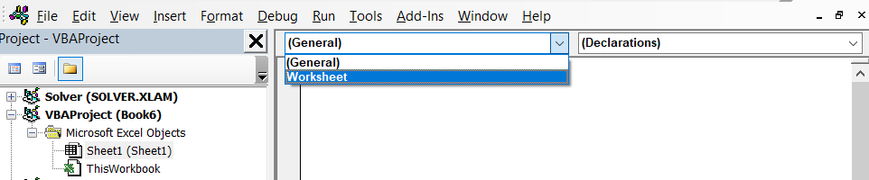
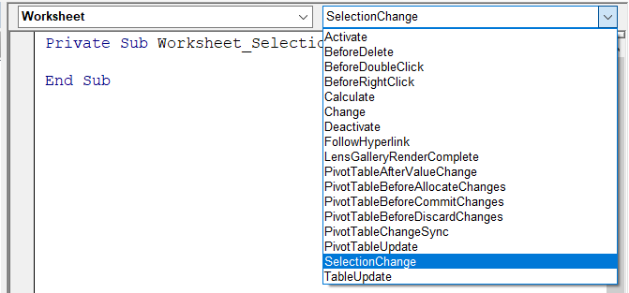
Accessing Worksheet Events
Worksheet Events can be accessed by going to the VBE.
Click on the Worksheet that you are expecting events to occur.
Click on the Property drop-down box and select worksheet.
Click on the procedures drop-down and select the event you want to react to.

Slide 114
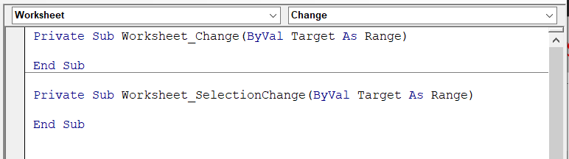
Accessing Worksheet Events
VBA will create a subroutine that will be triggered every time the event occurs.
You can place your VBA code within this subroutine and it will be executed every time the event occurs.

Slide 115
Range Object

Slide 116
The Range Object
The most important object when doing VBA programming is the Range Object. Most of the code you will be creating is, in one way or another, modifying or accessing cells, which is a Range object.
A Range is represented by one or more cells in a worksheet.
The Range object is the most important object in Excel VBA thus it has a lot of properties and methods

Slide 117
Referring to Ranges
There are several ways to refer to a range. Below is a list of objects you can use to refer or access a range.
Object Property Definition
Application ActiveCell Refers to the Active cell selected. Only one cell
Application Range Refers to the Range of the Active Worksheet
Application Selection Refers to the selected one or more cells
Worksheet Cells Refers to all the Cells of the Active Worksheet
Worksheet Column Refers to the Column of the Active Worksheet
Worksheet Range Refers to the Range of the Active Worksheet
Worksheet Row Refers to the Row of the Active Worksheet
Worksheet UsedRange Refers to the Range of Cells that has been used

Slide 118
Cells and Ranges (WorkSheet Object)
Most of the time in coding your VBA code, you will be using either the Cells or the Range property.
Cells is a property of the Worksheet Object that returns a range of all the Cells in the Sheet.
Cells is a collection object just like Workbooks and Worksheets.
More often you will be interested in a specific cell and that is where the Cells property is used.
Unlike the Workbooks and Worksheets Collection, the Cells collection is ordered by using a two-dimensional array (row and column)

Slide 119
Using Cells
The Cells property can be used using the following syntax:
workbook.worksheet.Cells.property
workbook.worksheet.Cells(rowNumber,columnNumber).property
where:
workbook – refers to the workbook where the cells are located.
worksheet – refers to the worksheet where the cells are located.
rowNumber – refers to the row of the Cell you are going to use.
columnNumber – refers to the row of the Cell you are going to use.
property – is the property or method of the Cells object you are going to use.

Slide 120
Using Range
When referring to a single cell, you can also use the Range property.
The Range property can also be used when referring to ranges(multiple cells), Rows, Columns and a cell
The general syntax for the Range object is:
workbook.worksheet.Range(Cell1, [Cell2]).property
where:
workbook – refers to the workbook where the range are located.
worksheet – refers to the worksheet where the range are located.
Cell1 – a string referring to a range when one argument is used or a Range object when two arguments are used.
Cell2 – defines another extremity of the range returned by the property. property – is the property or method of the Cells object you are going to use.

Slide 121
Referring Range
workbook.worksheet.Range(Cell1, [Cell2]).property
Cell1 parameter is required and can be a string that represent the address of a range. ie “A1”, “A1:B2”
When using 2 arguments, you can think of Cell1 as the upper left corner of a range and Cell2 as the bottom right corner of the range.
When using Named Ranges, Cell1 can be the string that represents a named range.
When formatting or entering formulas to a series of cells, it is much efficient to use the range property rather than formatting each cell one by one. The idea here is to refer to the range that needs the modification and apply the format or formula and it will affect all the cells in the Range.

Slide 122
Commonly Used Range Property
Some of the most commonly used Range property are as follows:
Value – Sets or gets the value of the Range
Range("A1").Value = “Cells” ‘Sets the Value of Cell A1 to Cells
param1 = Range("A1").Value ‘Get the value of Cell A1 and assign it to param 1
ClearContents – clears the contents of the range
Range("A1"). ClearContents ‘Sets the Value of Cell A1
Copy – Copies the range to the clipboard.
Range("A1:D5").Copy ‘Copies cells A1:D5 to the clipboard
using the destination argument of the copy method, will paste the copied cells to the range indicated on the destination argument
‘Copy cells A1:D5 to Range A7
Range("A1:D5").Copy Destination:=Range("A7")
End – this is like using the End key and then an arrow key or Ctrl + Arrow key. It is to find the the next blank cell or to find the next cell with value. This will return a Range value.
Range("A1"). ClearContents ‘Sets the Value of Cell A1

Slide 123
Commonly Used Range Property
End – this is like using the End key and then an arrow key or Ctrl + Arrow key. It is to find the next blank cell or to find the next cell with value. This will return a Range value. Should have an argument which is either xlDown, xlUp, xlToRight, or xlToLeft
‘returns the reference of the next blank cell downwards (if cell E1 is not empty)
Range(“E1").End(xlDown)
Cells(1,1).End(xlDown) ‘Another variation using Cells instead of Range
EntireRow or EntireColumn – returns a reference to the Range object that consists of the whole column/columns where the range is.
‘returns the reference of Column C to Column E
Range(“C3:E5").EntireColumn
‘returns the reference of Row 3 to Row 5
Range(“C3:E5").EntireRow
Note: You can also use the EntireRow and EntireColumn on the Cells Property, However, it will only return one Column or Row.
Formula – Used to enter a formula on referenced Range. The formula should be a string.
‘Set the formula for N2 to N12 to SUM($M$2:M2)
Range(“N2:N12").Formula = "=SUM($M$2:M2)“
Offset – returns a Range object which is rows and/or columns away from the reference.
Range(“E1"). Offset(2, 5) ‘Returns a reference for Cell J3

Slide 124
Commonly Used Range Property
PasteSpecial – Paste a range object that has been copied into the specified range.
Range(“E1"). PasteSpecial (Paste, Operation, SkipBlanks, Transpose)
Where:
Paste - You can use the Paste parameter to specify what gets pasted to the range. You can specify one of the xlPasteType constants: xlPasteAll (default), xlPasteAllExceptBorders, xlPasteColumnWidths, xlPasteComments, xlPasteFormats, xlPasteFormulas, xlPasteFormulasAndNumberFormats, xlPaste-Validation, xlPasteValues, and xlPasteValuesAndNumberFormats.
Operation – The Operation parameter specifies whether to perform any special actions to the paste values in conjunction with any values that already occupy the range. You can use one of the xlPasteSpecialOperation constants: xlPasteSpecialOperationAdd, xlPasteSpecialOperationDivide, xlPasteSpecialOperationMultiply, xlPasteSpecialOperationNone (default), and xlPasteSpecialOperationSubstract.
SkipBlanks – This Boolean (true/false) parameter specifies whether or not to ignore any blank cells on the Clipboard when pasting. By default this parameter is false.
Transpose – This optional Boolean parameter transposes rows and columns. If you have a series of values oriented horizontally, and you paste it using the value true for the Transpose parameter, you’ll end up with a series of values oriented vertically.

Slide 125
Commonly Used Range Property
Find – Paste a range object that has been copied into the specified range.
Range(“A1:E100"). FindFind(What, [After], [LookIn], [LookAt], [SearchOrder], _
[SearchDirection As XlSearchDirection], [MatchCase], [MatchByte], [SearchFormat]) As Range
Where:
What – Data to search for. Required parameter
After – optional parameter which specifies the cell after which the range should be searched. Range Object.
LookIn – use the LookIn parameter to specify where to look for the item. You can use one of the defined constants xlValues, xlFormulas or xlComments.
LookAt – Use LookAt to specify whether Find should only consider the entire contents of a cell or whether it attempts to find a match using part of a cell. You can use the constants xlWhole or xlPart.
SearchOrder – The SearchOrder parameter determines how the range is searched: by rows (xlByRows) or by columns (xlByColumns).
SearchDirection - Do you want to search forward (xlNext) or backward (xlPrevious). By default, the SearchDirection is forward.
MatchCase – This parameter is false by default; this means that normally the search is not case sensitive (A=a).
MatchByte – s If you have selected or installed double-byte language support, this should be true to have double- byte characters match only double-byte characters. If this is false, double-byte characters match their single-byte equivalents.
SearchFormat – Use this value if you’d like to specify a certain type of search format

Slide 126
Commonly Used Range Property
Replace – Replaces text within the cells in the specified range.
Range(“A1:E100"). Replace What, Replacement, [LookAt], [SearchOrder], [MatchCase], _ [MatchByte], [SearchFormat], [ReplaceFormat] As Boolean
Where:
What – Data to search for. Required parameter
Replacement – Replacement and What are the only required parameters for Replace. Replacement is the value substituted for the value supplied by the What parameter.
LookAt – xlPart (default) searches within the cell contents; xlWhole searches whole cells.
SearchOrder – xlByRows (default) searches one row at a time; xlByColumns searches one column at a time.
MatchCase – False (default) ignores case; True performs a case-sensitive search
MatchByte – You can use this argument only if you have selected or installed double-byte language support in Microsoft Excel
SearchFormat – SearchFormat is an optional Boolean value that instructs Replace to look for the format described by the Application.FindFormat
ReplaceFormat – ReplaceFormat is an optional Boolean value that instructs Replace to apply the format described by the Application.ReplaceFormat object to any cell in which Replace substitutes a value.

Slide 127
- EOF -

